Slide 1
Time Series Analysis:
Multivariate Autoregression and Granger Causality
CSC8980
Yutong Gao
Varaprasad Kurra

Slide 2
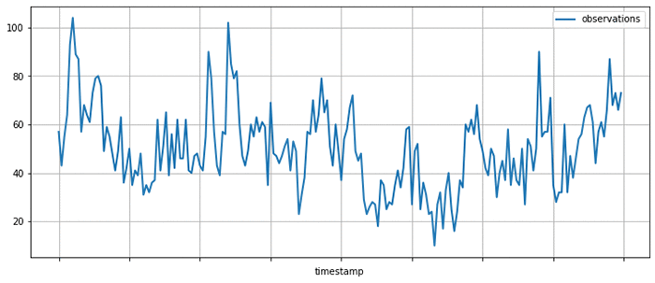
What is Time Series Data?
Time series data is a collection of observations obtained through repeated measurements over the time. Plot the points on a graph, and one of your axes would always be time.
Dependending on the number of dependent variables. We have two types of Times Series data.
Types:
Univariate Time Series
Multivariate Time Series

Slide 3
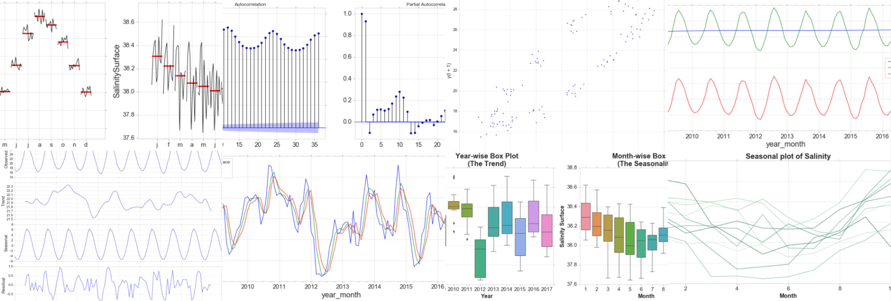
What is Time Series Analysis?
Time Series Analysis comprises of methods for analyzing time-series in order to extract meaningful statistics and other characteristics of the data.
Time Series forecasting is to use a model to predict the future values based on the previously observed values.
Methods for time series analysis may be divided into two classes:
Frequency Domain
Spectral Analysis
Wavelet Analysis
Time Domain
Autocorrelation
Cross Correlation

Slide 4
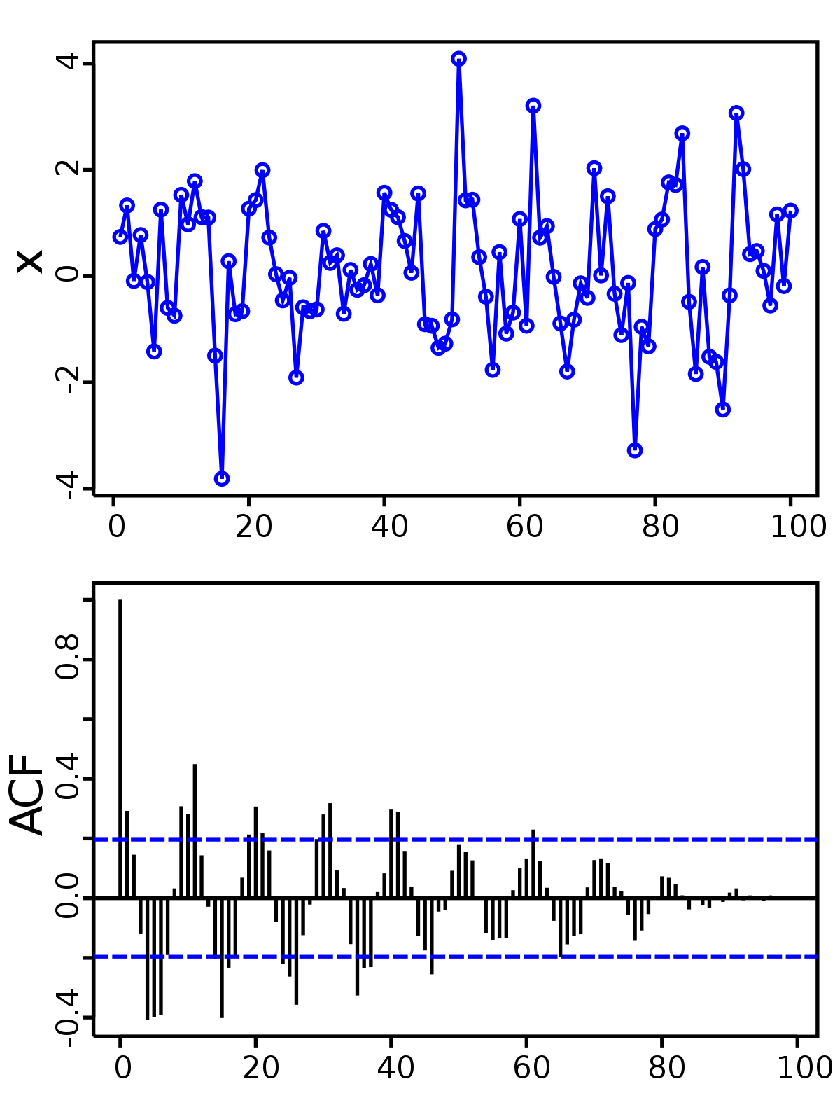
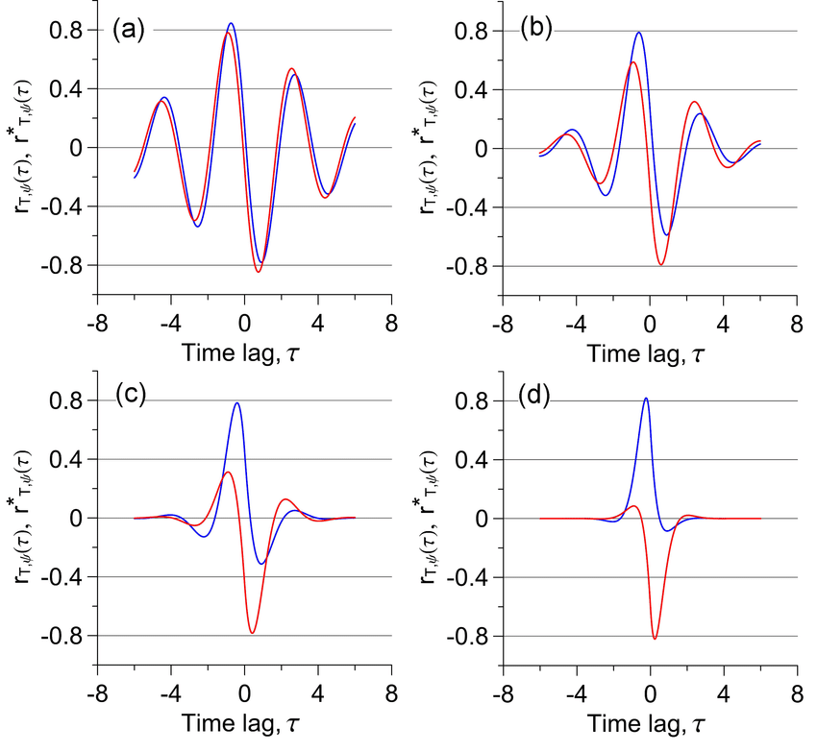
Cross Correlation ( Two Times Series)
Autocorrelation
similarity of two series as a function of the displacement of one relative to the other.
similarity between a given time series and a lagged version of itself
Notes:
Autocorrelation, also known as serial correlation, is the correlation of a signal with a delayed copy of itself as a function of delay.It is often used in signal processing for analyzing functions or series of values, such as time domain signals.
Cross-correlation is generally used when measuring information between two different time series. The range of the data is -1 to 1 such that the closer the cross-correlation value is to 1, the more closely the information sets are. ... Cross-correlation can also occur with sets and time series of data.

Slide 5
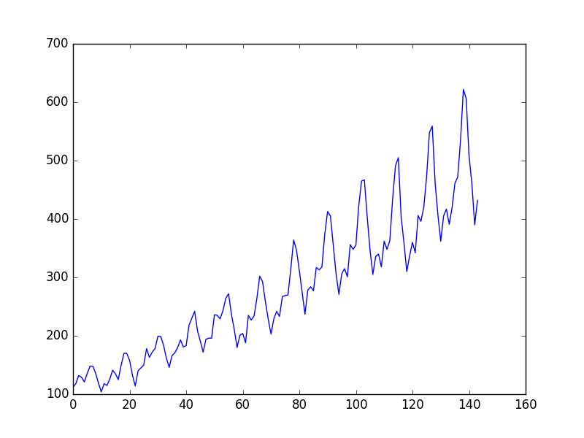
Univariate Time Series?
Univariate analysis is the simplest form of analyzing data. “Uni” means “one”, so in other words your data has only one variable.
It doesn’t deal with causes or relationships (unlike regression) and it’s major purpose is to describe.
It takes data, summarizes that data and finds patterns in the data.
Notes:
A univariate time series is a sequence of measurements of the same variable collected over time. Most often, the measurements are made at regular time intervals. One difference from standard linear regression is that the data are not necessarily independent and not necessarily identically distributed.

Slide 6
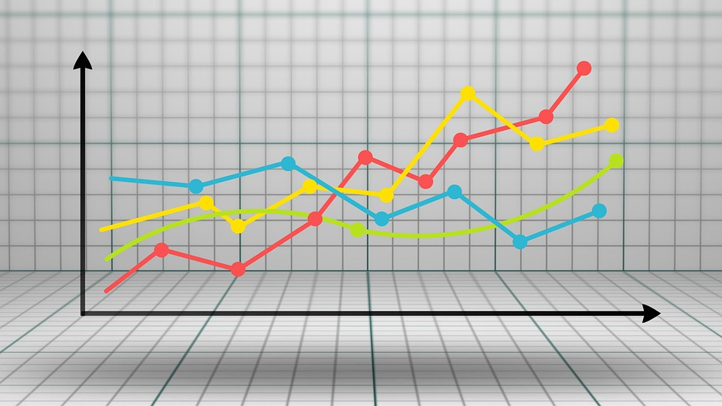
Multivariate Time Series
A Multivariate time series has more than one time-dependent variable.
Each variable depends not only on its past values but also has some dependency on other variables.
This dependency is used for forecasting future values.
Notes:
A Multivariate time series has more than one time-dependent variable. Each variable depends not only on its past values but also has some dependency on other variables. This dependency is used for forecasting future values. In this case, there are multiple variables to be considered to optimally predict temperature.

Slide 7
The Multivariate Autoregressive Models
Autoregression is a time series model that uses observations from previous time steps as input to a regression equation to predict the value at the next time step.
Given a univariate time series, its consecutive measurements contain information about the process that generated it. Autoregressive(AR) is a simple, yet effective, approach to time series characterisation. Output variable depends linearly on its own previous values and on a stochastic term.
Multivariate autoregressive modeling (MAR modeling) is a time series analysis procedure often used to characterize dynamic systems because of its simplicity.
How MAR works
Consider d time series generated from d variables within a system such as a functional network in the brain. A MAR model predicts the next value in a d-dimensional time series, yn as a linear combination of the m previous vector values.

Slide 8
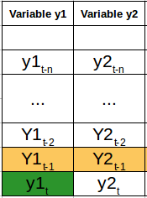
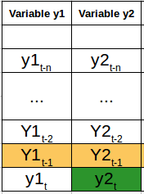
Dealing with a Multivariate Time Series – VAR
Assumption:
VAR is a data-driven approach, assumes that connected regions exert time-lagged influences on one another.
In a VAR model, each variable is a linear function of the past values of itself and the past values of all the other variables.
We have two variables, y1 and y2. We need to forecast the value of these two variables at time t, from the given data for past n values. For simplicity, I have considered the lag value to be 1.

Slide 9
Vector Autoregression (VAR).
For calculating y1(t), we will use the past value of y1 and y2. Similarly, to calculate y2(t), past values of both y1 and y2 will be used. Below is a simple mathematical way of representing this relation:
Here,
a1 and a2 are the constant terms, because this makes them better able to model the systems they represent.
w11, w12, w21, and w22 are the coefficients,
e1 and e2 are the error terms

Slide 10
Why do we need VAR?
Vector Autoregressive (VAR) model to characterize interactions between hemodynamic activity at different ROIs.
Time-series data is autoregressive in nature (serially correlated).
VAR model is one of the most successful and flexible models for the analysis of multivariate time series.
Especially useful for describing the dynamic behavior of neural(dynamic) time series.
Model-based forecast. In general VAR encompasses correlation information of the observed data and use this correlation information to forecast future movements or changes of the variable of interest.

Slide 11
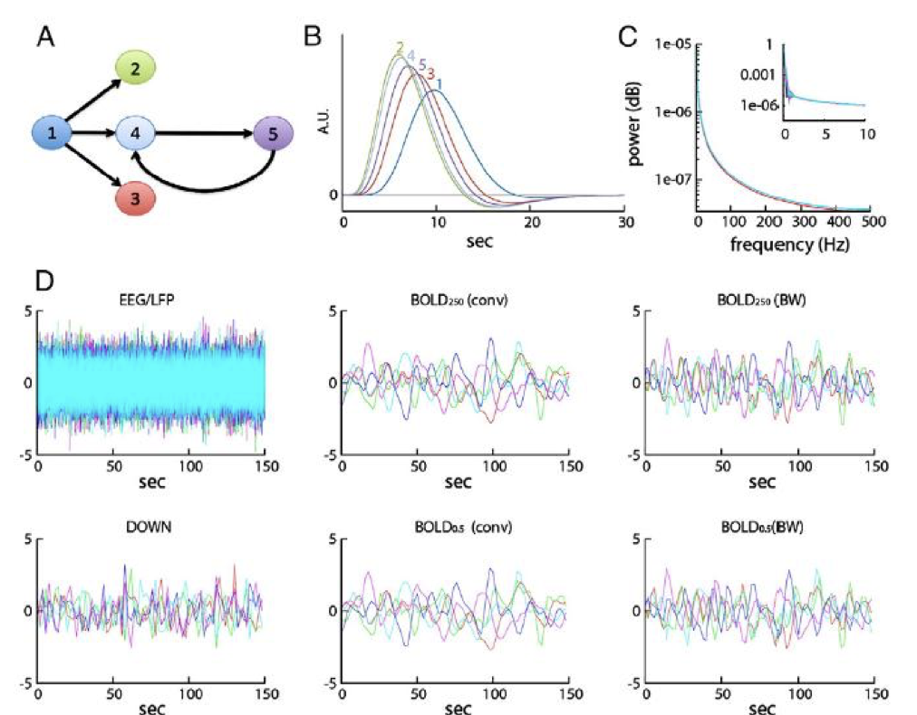
VAR models in Neuroscience
Identify connectivity among brain regions from time course fMRI data.
Vector autoregressive (VAR) models typically form the basis for constructing directed graphical models for investigating connectivity in a brain network with brain regions of interest (ROIs) as nodes.

Slide 12
Advances in VAR
VAR has its own limitations.
One limitation of the models that we have considered so far is that they impose a unidirectional relationship — the forecast variable is influenced by the predictor variables, but not vice versa.
VAR is overparameterized.
The unifying model, structural vector autoregression (SVAR), may improve statistical and explanatory power, and avoid some prevalent pitfalls that can occur when VAR.
Bayesian Vector Autoregressive Model.

Slide 13
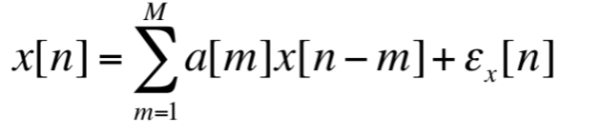
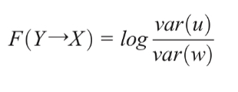
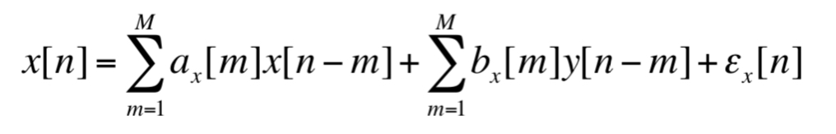
Granger Causality(GC)
To consider the causal influence one neural time series can exert on another, if the prediction of one time series could be improved by incorporating the knowledge of a second one, then the second series is said to have a causal influence on the first
if the variance of the autoregressive prediction error of the first time series at the present time is reduced by inclusion of past measurements from the second time series, then the second time series is said to have a causal influence on the first one.
Fit the univariate model for X alone: Calculate the Granger causality: in range of [0,∞)
Fit the bivariate model:
u
w
Notes:
In neuroscience, signals of interest are often collected in the form of multiple simultaneous time series.

Slide 14
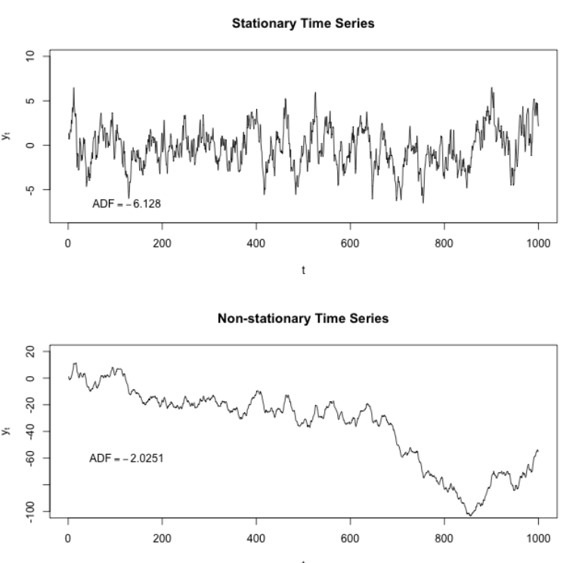
Assumptions of GC - Weak Stationary
Stationarity is that the probability laws that govern the behavior of the process do not change over time. Consequently, parameters such as mean and variance also do not change over time
Weak Stationarity, also known as covariance stationarity has its mean function and correlation function do not change by shifts in time
Prerequisite of the Granger Causality: Each block ended with a “weak stationary” condition
To check the stationary: Augmented Dickey-Fuller test, or phillips-Perron test or KPSS test (unit root test)
If not stationary, we can preprocessing the data: shorten the windows; detrending, differencing, smoothing
*not too strict on stationarity, non-stationarity can be the informative part in fMRI

Slide 15
When testing on more variables…
pairwise connectivity/causal among different ROI(manually selected/ICA)
Estimating and comparing two VAR models to find the G-causes
Full AR model:
estimated jointly for all the variables
Reduced AR model:
estimated jointly but omit the potential factor
Eg. find the G-causes of X to Y
Full VAR model:
X_{t-1}, Y_{t-1}, Z_{t-1}, A_{t-1},...jointly predict Y_{t} with prediction error u
Reduced VAR model:
Y_{t-1}, Z_{t-1}, A_{t-1},...jointly predict Y_{t} with prediction error v
Conclusion:
X has G-causes to Y under the condition of Z, A, ...
The best number of lag to perform VAR(MAR):
Model order(lag) selection:
Bayesian estimation
Akaike information criterion
Rule of thumb
Rest on data instead of underlying physical mechanism
High sampling rate need larger number of order and vice
Notes:
Approach 1: conders a specific seed region of interest and computes connectivity between it and every brain voxel using a bivariate model in each case
Approach 2: a number of regions of interest may be included in the same multivariate AR model, and all pairwise connectivity measure calculated
Approach 3: apply ICA to separate the source and perform multivariate AR model between separate components

Slide 16
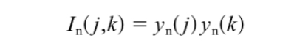

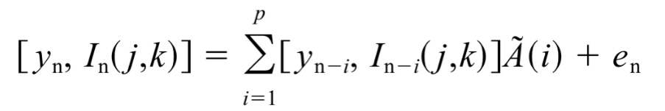
Relationship of Causality
Linear Relationship:
Non-linear Relationship: Bilinear term
model a hypothesized interaction between variables
form an augmented MAR model with an extra time series and augmented connectivity matrices
reflect modulatory influences: a change of the connection strength between y(j) and other time series due to the influence of y(k)

Slide 17
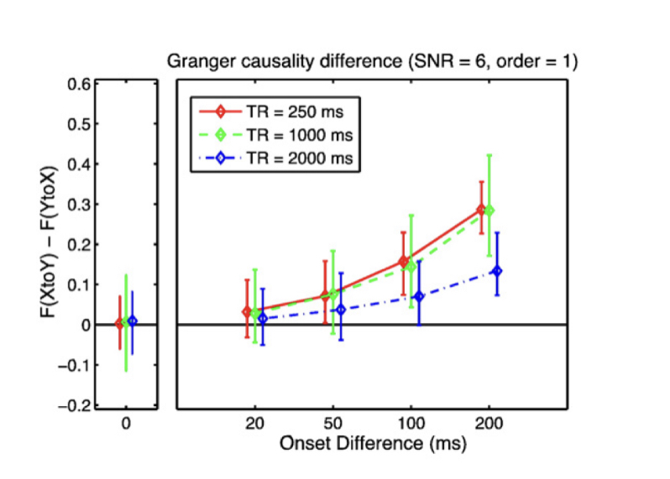
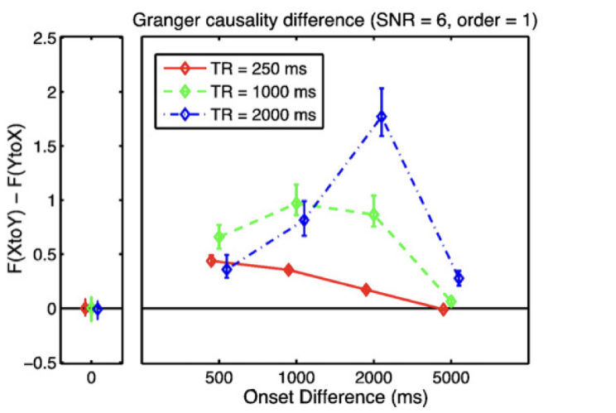
Basic Property
Simulation Experiment: Five minutes BOLD time series were simulated for two regions of interest X and Y. The neural event for Y was delayed relative to that for X by a value between 0 ms to 5s.(Gaussian noise was added to make the SNR=6)
As Y’s onset delay increased, the causality difference increased up to an onset delay around 2s.
Decreasing sensitivity of Granger Causality when time difference were too large.
A faster sampling rate gave better sensitivity to small onset difference
Limitation in real-case: typical whole-brain fMRI sampling rate of 1-2s, the sensitivity of GC decreases.
(but works on study much slower effect, eg motor task-motor fatigue)
Concern: slice timing -(slice timing correction, PRESTO)

Slide 18
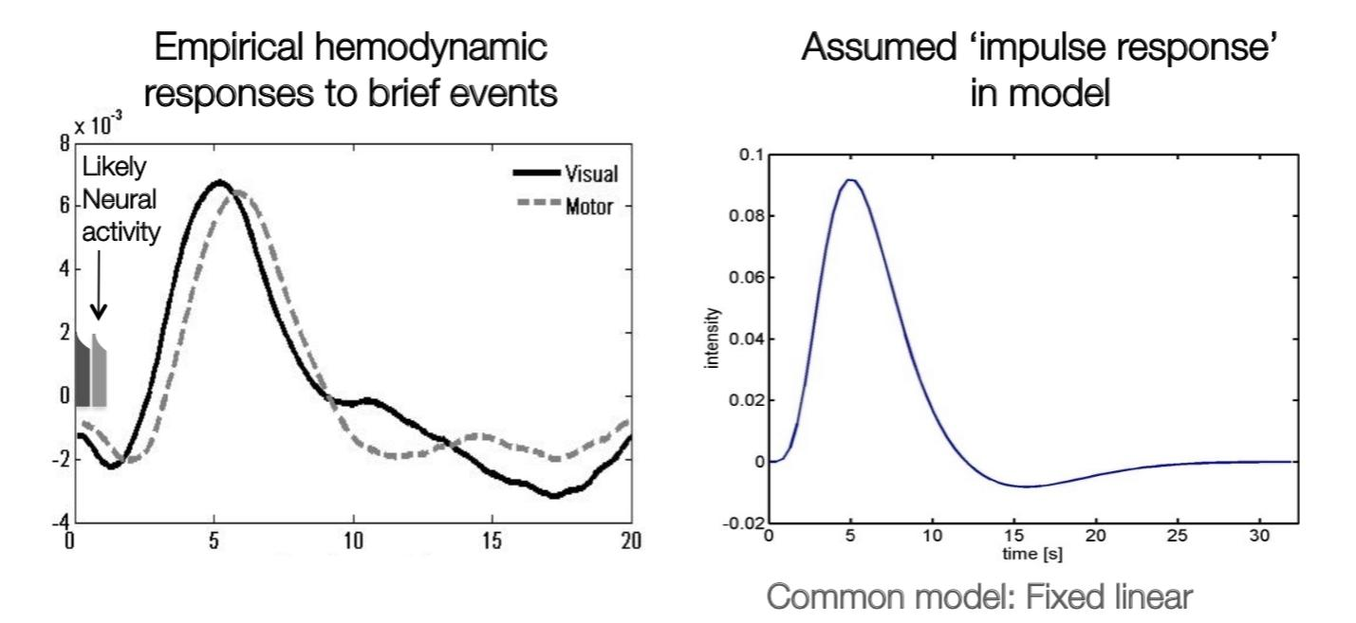
Hemodynamic Response Function variability
BOLD signal has stereotyped shape every time a stimulus hits it.
Scenario: region X causally influence region Y at the region Y at the neuronal level, but HRF for X has a longer time-to-peak than the HRF for Y.
Will the inter-regional HRF differences conformed results?
Eg. inference Y G-causes X
No, GC inferences are robust to a wide variety of changes in HRF properties including notably their time-to-peak. (Seth et al.,2013)
Exception: in some cases: HRF changes are rest on severe downsampling(focus on hemodynamics rather than the neural mechanisms), or excessive measurement noise
BOLD response are delayed and dispersed relative to neural activity
Peaks at 4-6s poststimulus; baseline after 20-30s
Pattern similar across brain regions, but still exception
Lindquist et al. , 2008
Notes:
spm_hrf.m in SPM toolbox to
% produce HRF
Convolution kernel-time-to-peak

Slide 19
Conclusion and other..
Autoregression can be the methods to investigate the causality relationship between time series data, also forecasting
GC as distance metric for clustering: GC is more sensitive in small difference BOLD response than Euclidean distance, correlation coefficient
Granger Causality performs better to find G-causes under short sampling rate and little noise
Use carefully: on the experiment setting and data acquisition method with respect to the assumption
Interpret the result carefully: GC does not make direct claims about underlying physical-causal mechanisms; fundamentally about describing observed data in terms of directed functional interactions or information flow (some authors prefer term “Granger Prediction” Cohen, 2014)
Notes:
apply to time series from a multivoxel region of interest to separate the difference neural response to improve the spatial specificity of fMRI activation maps.

Slide 20
References
Rogers, Baxter P et al. “Functional MRI and multivariate autoregressive models.” Magnetic resonance imaging vol. 28,8 (2010): 1058-65. doi:10.1016/j.mri.2010.03.002
Seth, Anil K., et al. “Granger Causality Analysis in Neuroscience and Neuroimaging.” Journal of Neuroscience, vol. 35, no. 8, Feb. 2015, p. 3293. EBSCOhost, search.ebscohost.com/login.aspx?direct=true&AuthType=ip,shib&db=edb&AN=101201935&site=eds-live&scope=site.
Harrison, L., et al. “Multivariate Autoregressive Modeling of FMRI Time Series.” Neuroimage, vol. 19, no. 4, Jan. 2003, pp. 1477–1491. EBSCOhost, doi:10.1016/S1053-8119(03)00160-5.
Seth, Anil K., et al. “Granger Causality Analysis of FMRI BOLD Signals Is Invariant to Hemodynamic Convolution but Not Downsampling.” NeuroImage, vol. 65, Jan. 2013, pp. 540–555. EBSCOhost, doi:10.1016/j.neuroimage.2012.09.049.

Slide 21
Any Questions?

